Slide 1
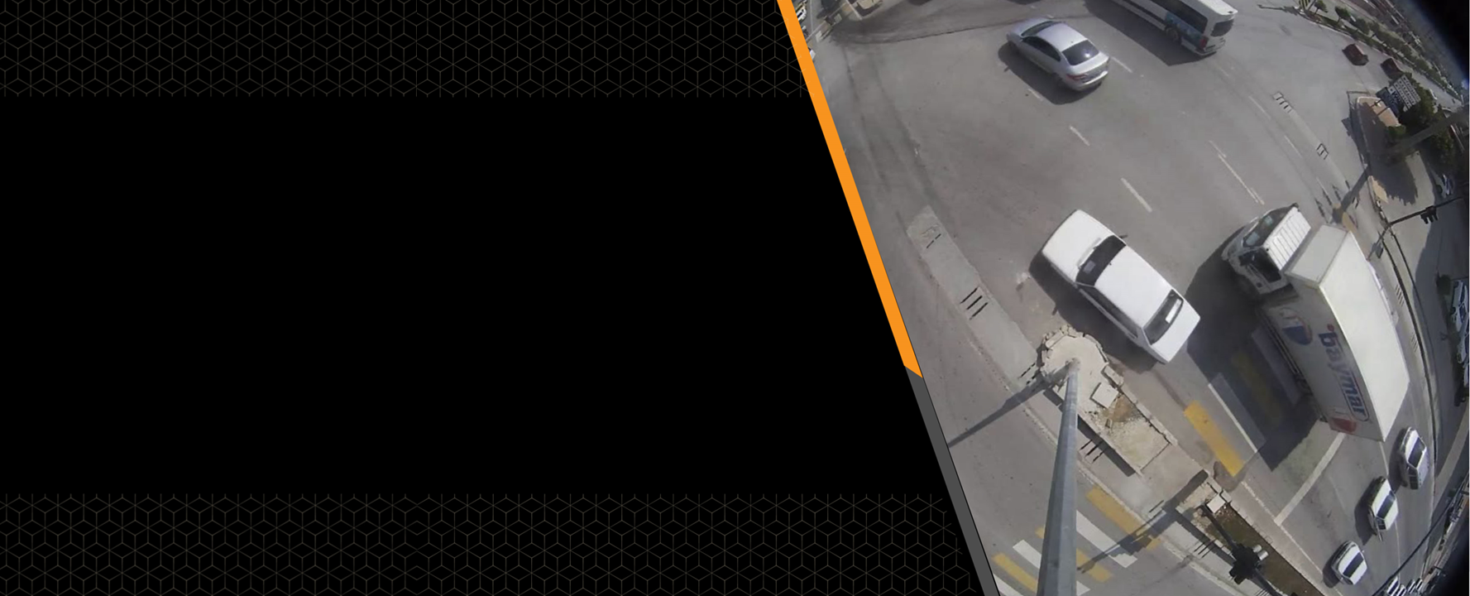
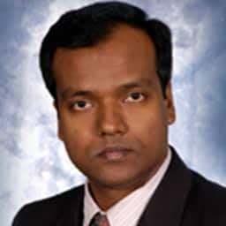

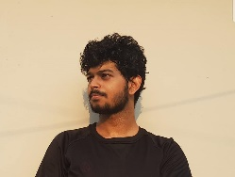
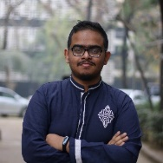
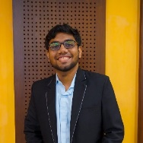
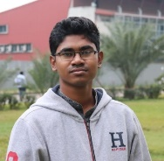

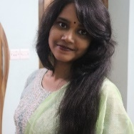
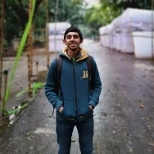
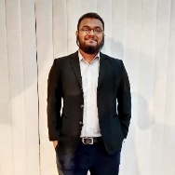

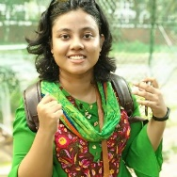

IEEE VIP CUP 2020
Real-time vehicle detection and tracking at junction
using a fisheye camera
TEAM MULTILAYER PERCEPTRON
Dr. Shaikh Anowarul Fattah
Supervisor
Tanvir Mahmud
Postgraduate
Maisoon Rahman
Undergraduate
Md Jahin Alam
Undergraduate
Md Shariar Azad
Undergraduate
Tanvir Anjum
Undergraduate
Md Awsafur Rahman
Undergraduate
Najibul Haque Sarker
Undergraduate
Muhammad Zubair Hasan
Undergraduate
Barproda Halder
Undergraduate
Bishmoy Paul
Undergraduate
Tasnim Nishat Islam
Undergraduate

Slide 2
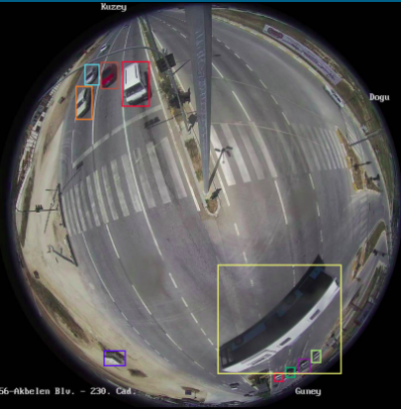
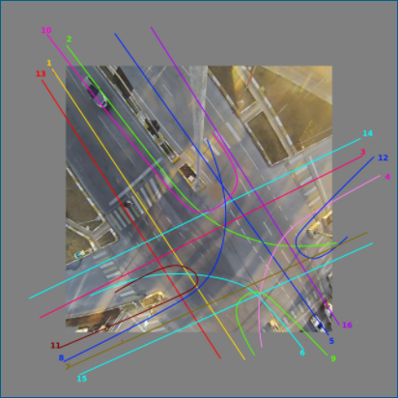
Problem Overview
Tasks
Vehicle detection
2. Vehicle Tracking

Slide 3
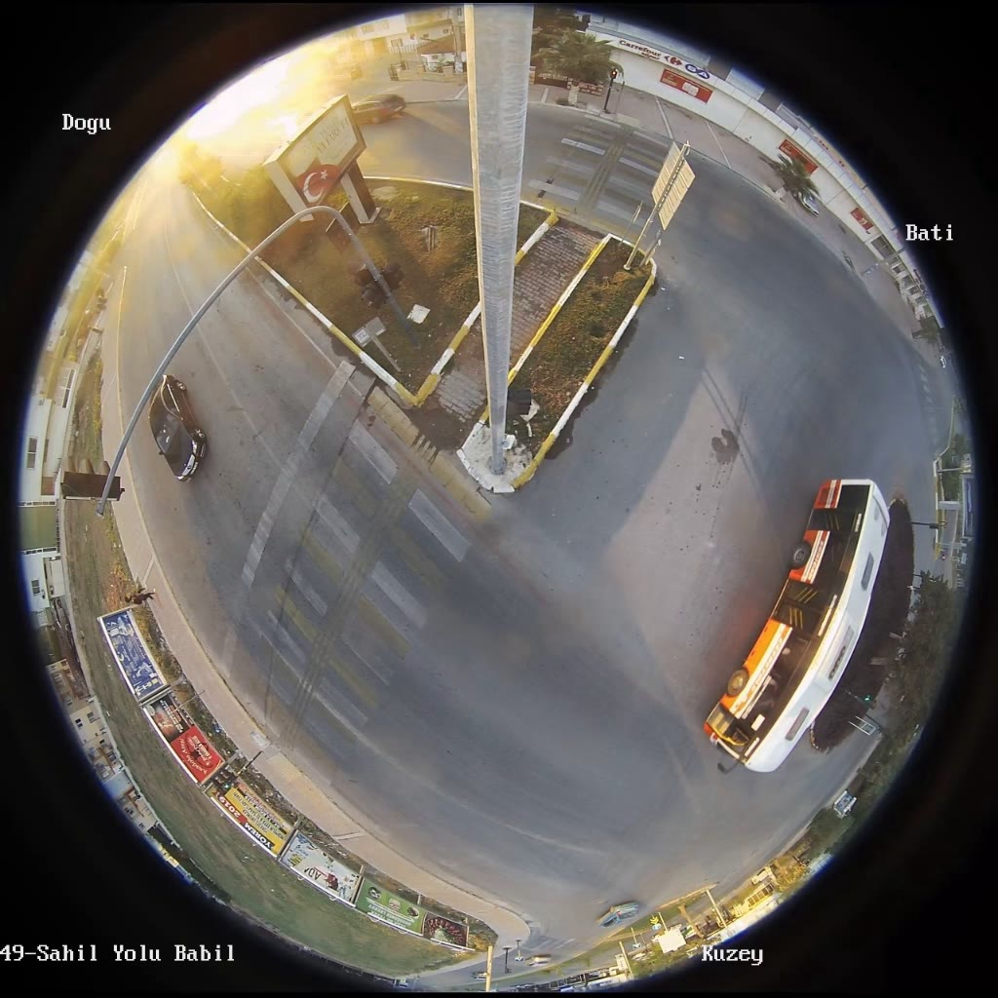
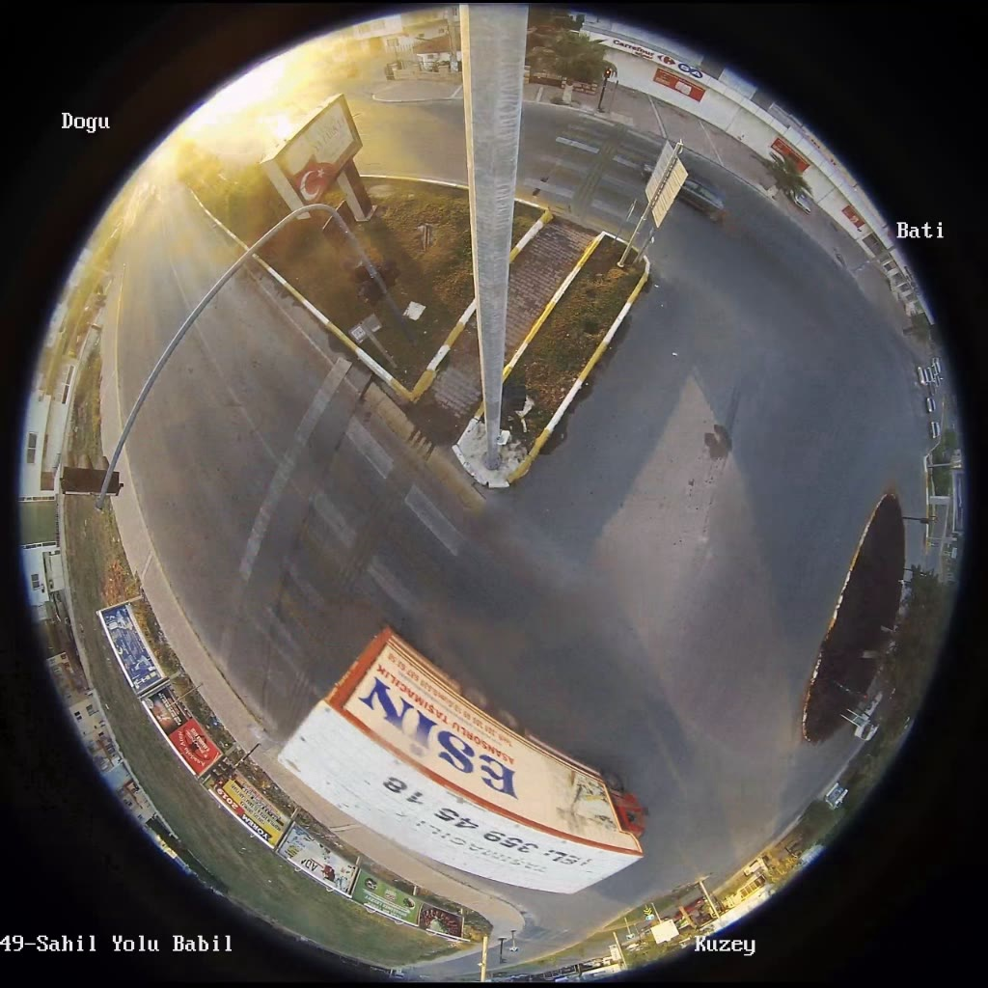
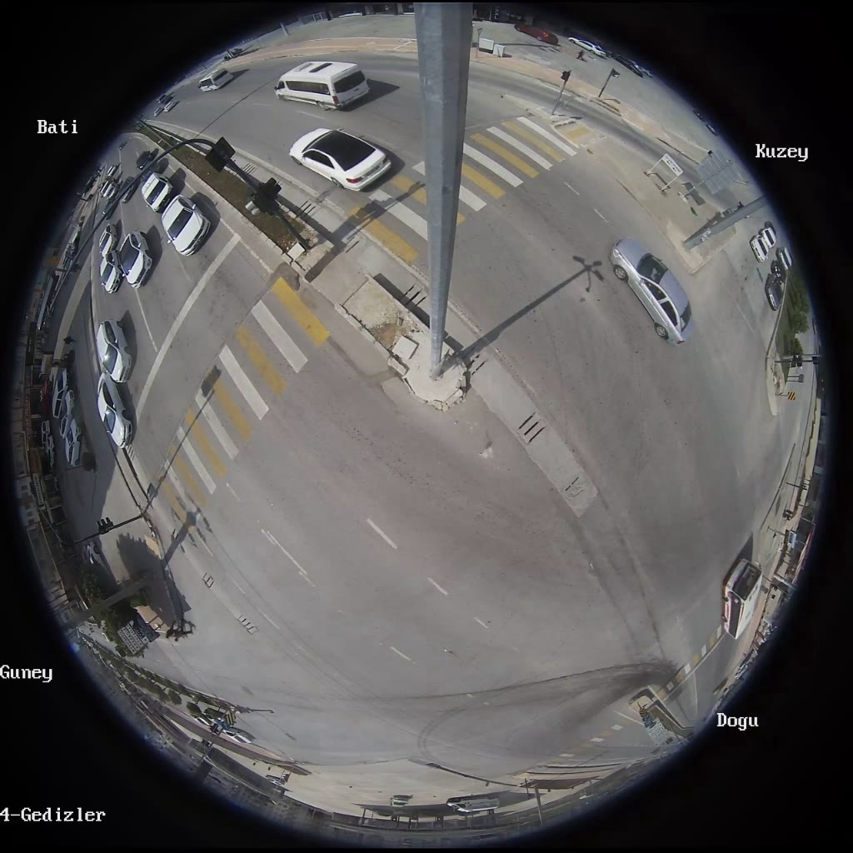
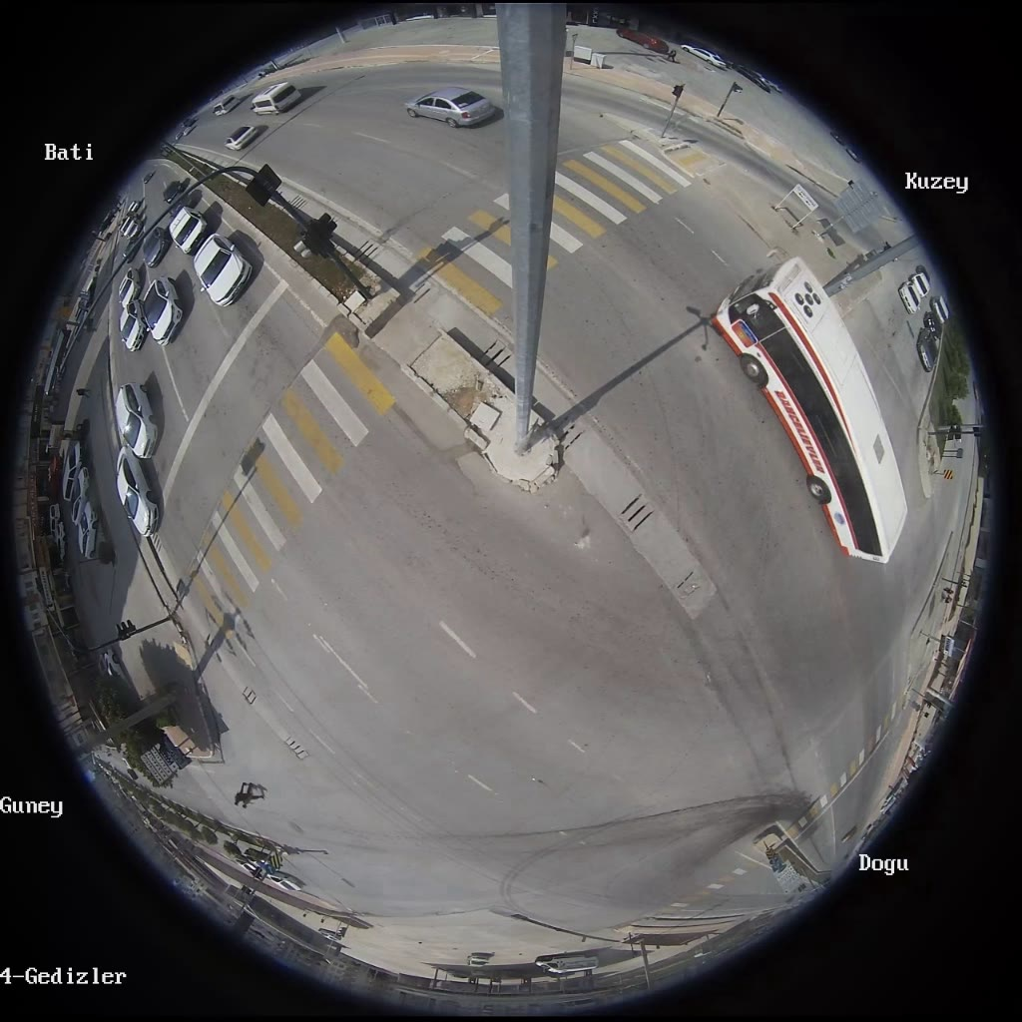
Challenges
High distortion ratios.
Different scales of same object moving in different parts of the image.

Slide 4
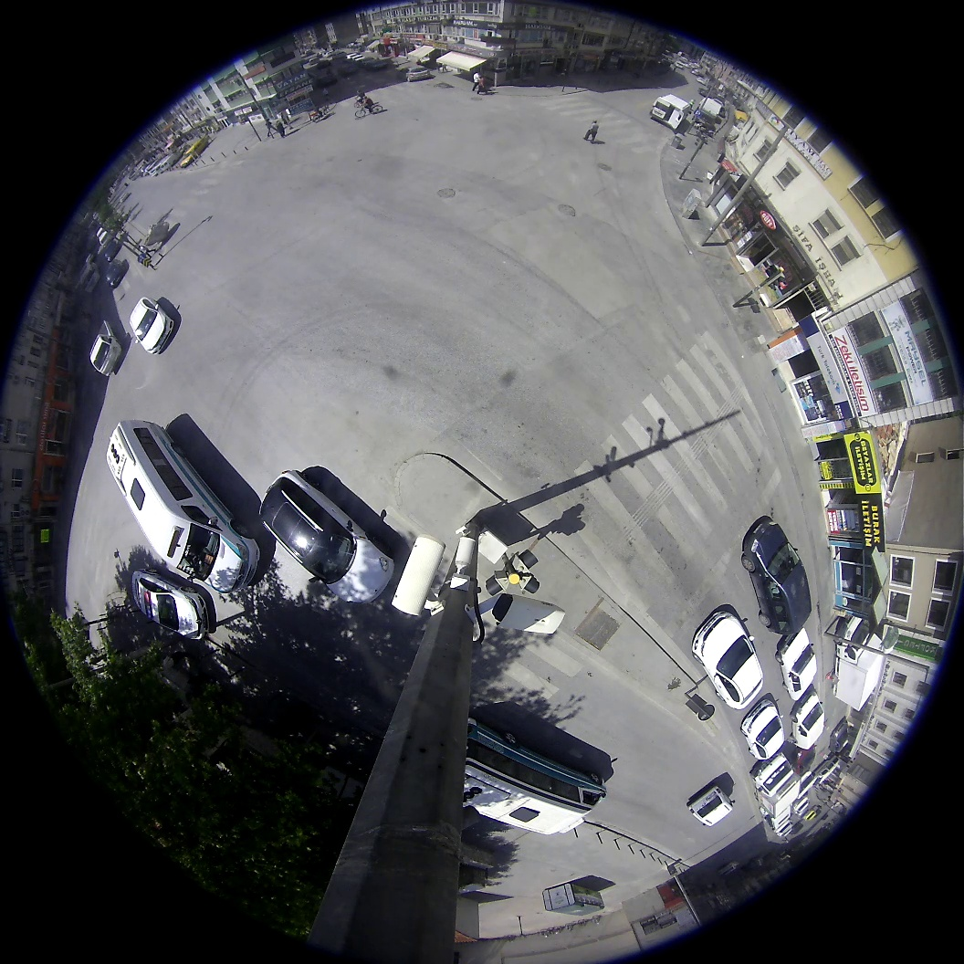
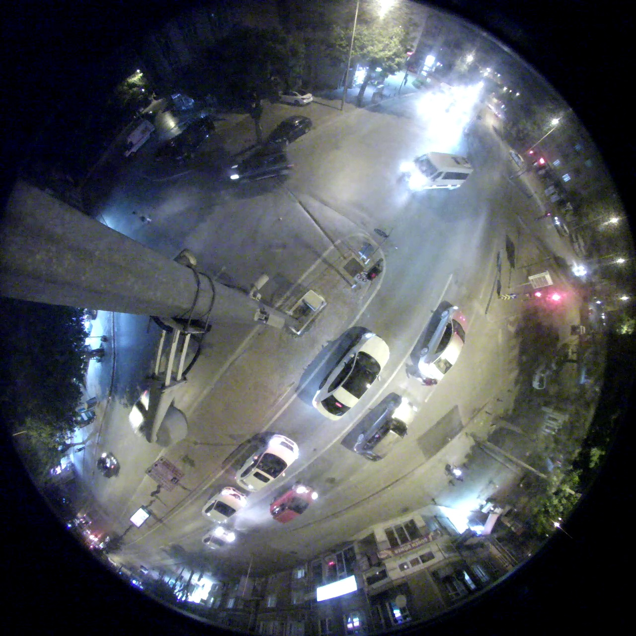
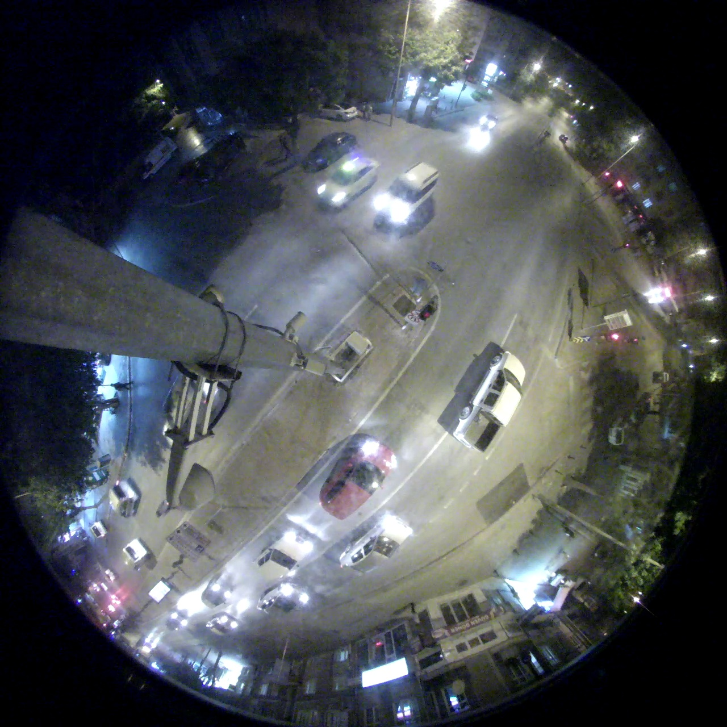
Challenges
Day/Night views variance, as night view suffers from low quality related to lighting conditions
Exposure introduced with vehicle lights in night view.

Slide 5
Challenges
Imbalance between different types of vehicles
Big
Small
5%
60%
Different Types
Imbalance between Day and Night cases.
Day
Night
67%
33%
Day or Night

Slide 6
Dataset Distribution
Fisheye Dataset
 | Training | Validation | Total
Day | 20.3K | 1.66K | 21.96K
Night | 9.4K | 1.16K | 10.56K
Total | 29.7K | 2.82K | 32.52K

Slide 7
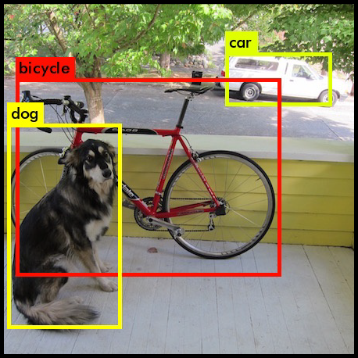

Solution
Vehicle Detection
Object Detection
Deep Learning

Slide 8
Experimented Models
YOLOv3
YOLOv4
YOLOv5
EfficientDet

Slide 9
Experimented Models
YOLOv3
YOLOv4
YOLOv5

Slide 10
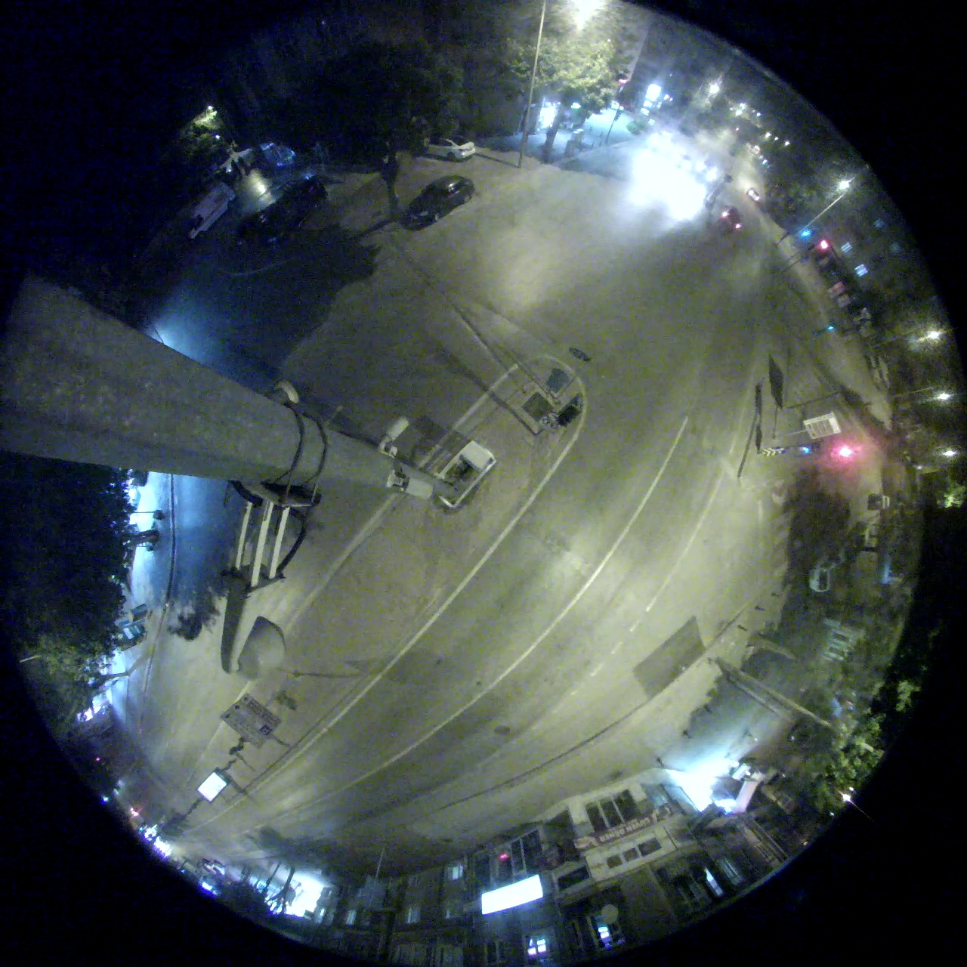
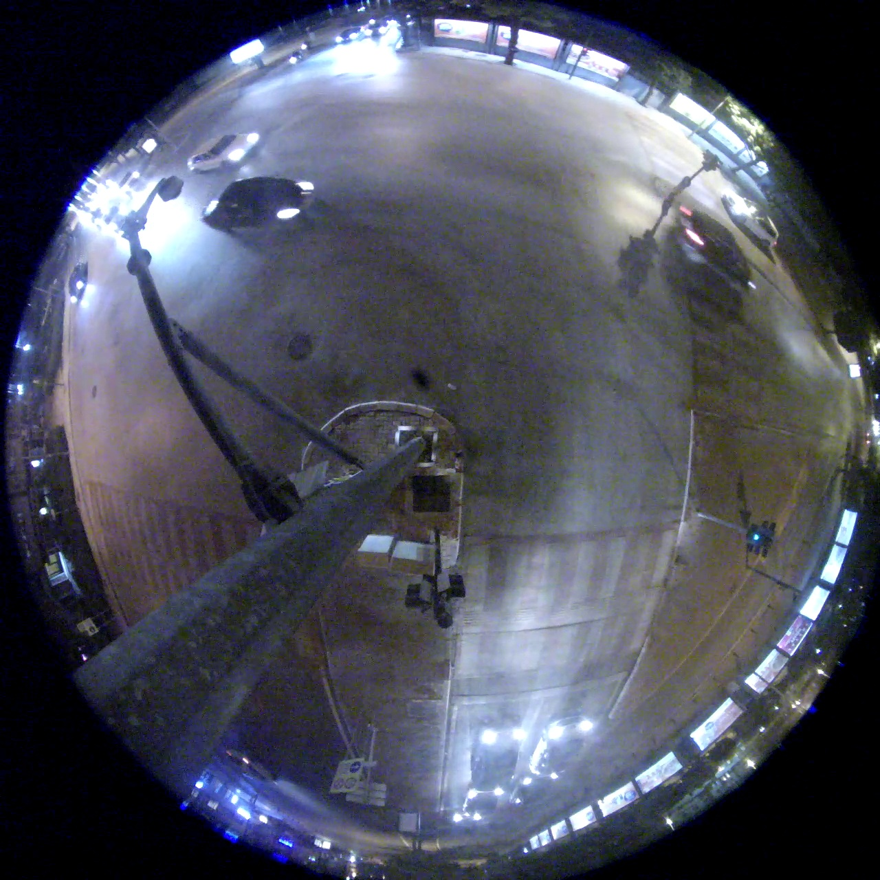
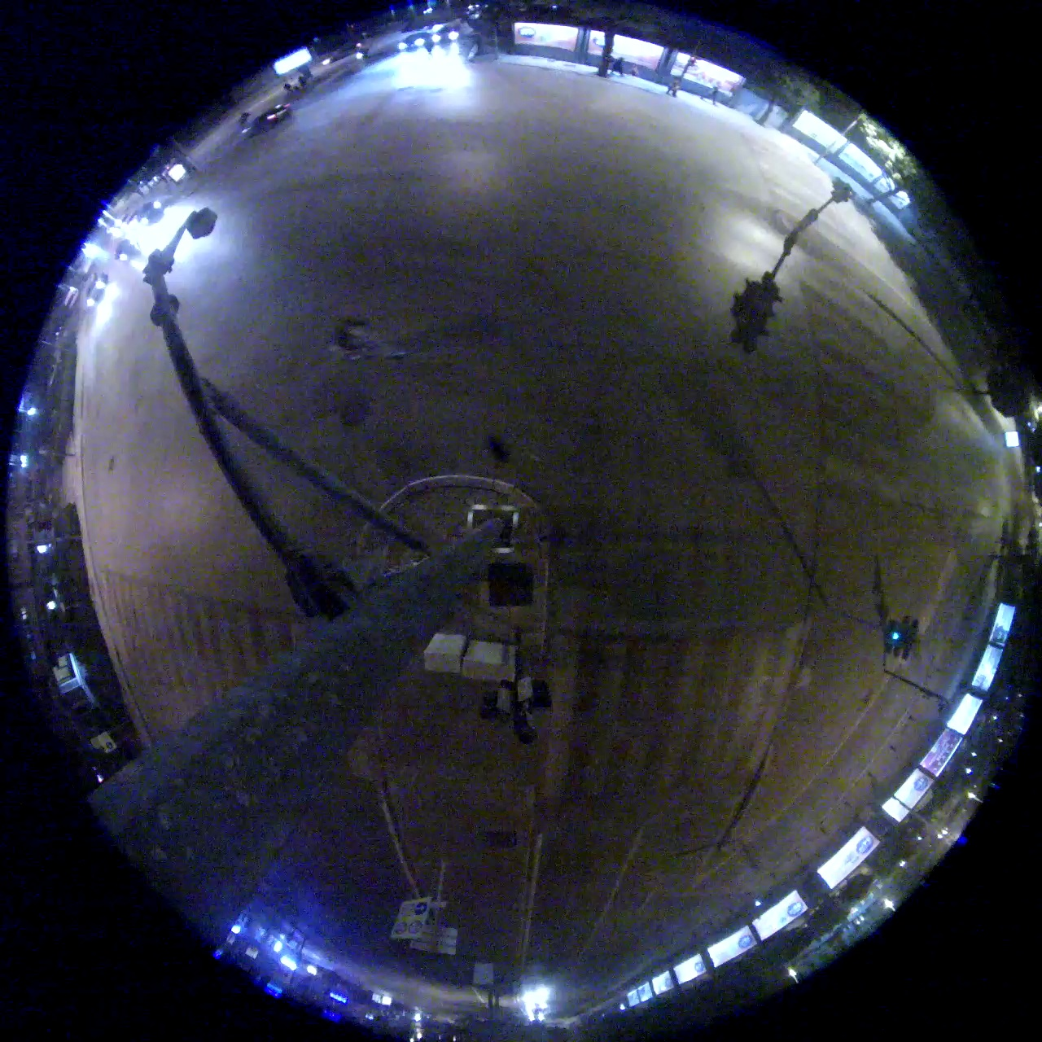
Our Proposal
Separate Day from Night
Reason
Night Data hurts Day Training
Glare
Noise
Low Brightness

Slide 11
Our Proposal
Separate Day from Night
Solution
Use a Day and Night separator model.
YES
Day Pipeline
Day-Night
Differentiator
OUTPUT
DAY?
Input
Image
Night Pipeline
NO

Slide 12
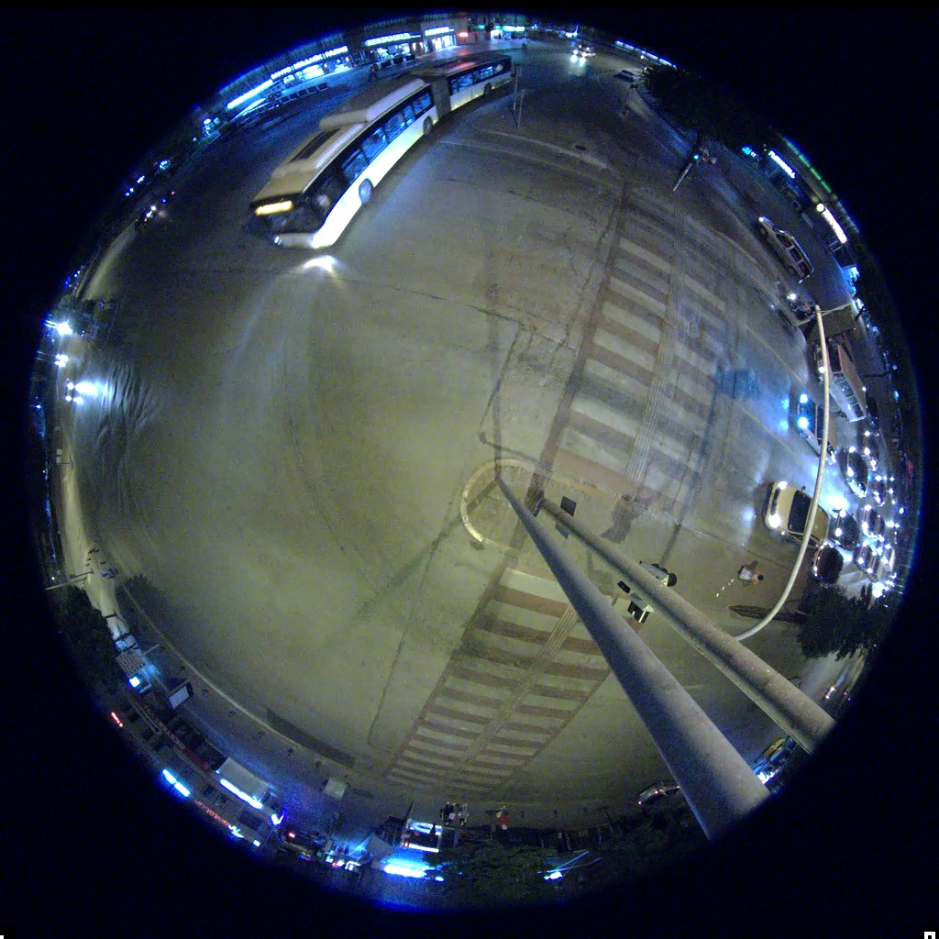
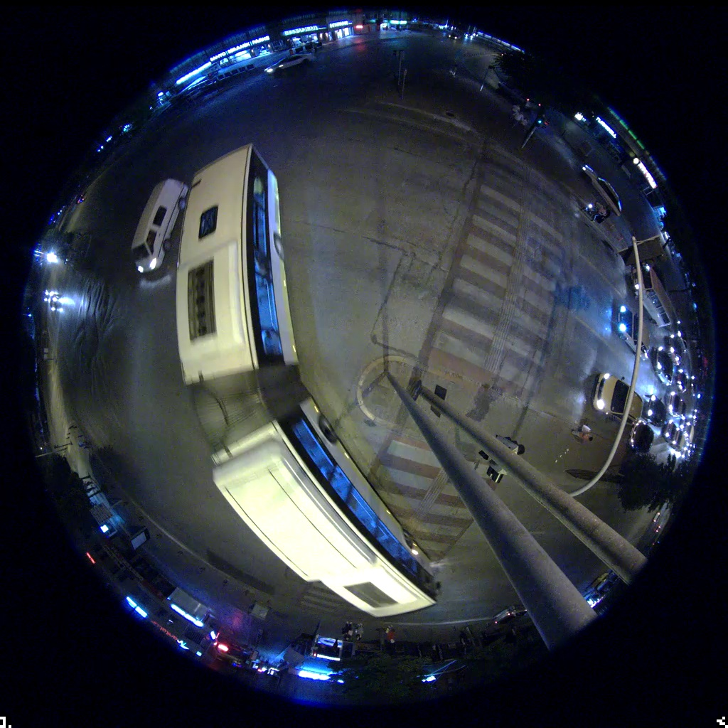
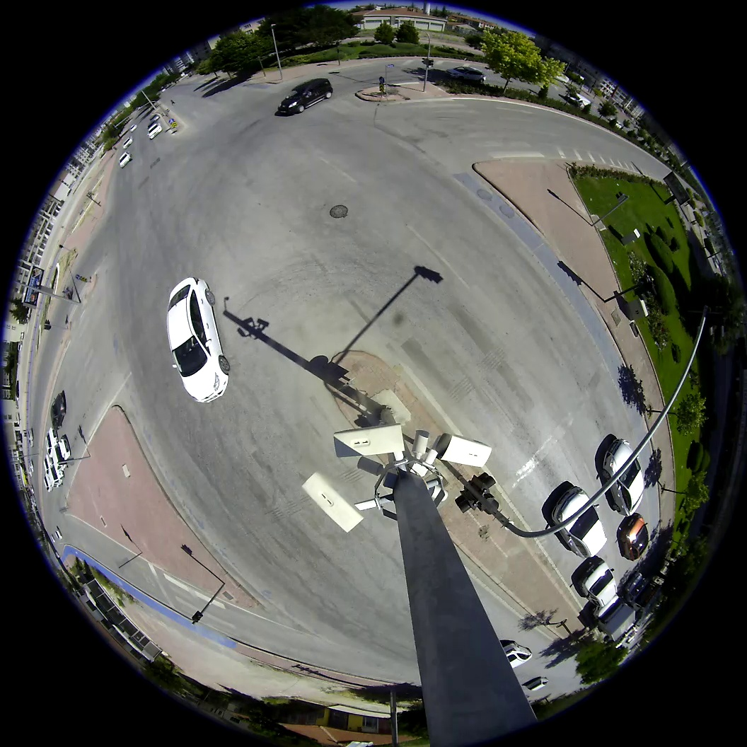
Our Proposal
Challenging Cases
Which Cases
Very big, very small
Unusual car
Camera
Solution
Upsampling

Slide 13
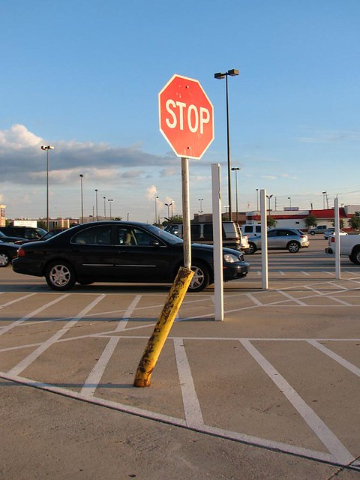
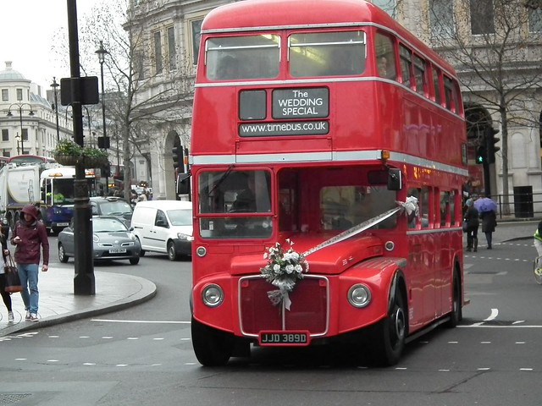
Our Proposal
Multi-stage transfer learning
COCO Dataset
Ex-1
Ex-2
Complication
Coco dataset has 80 classes which includes person, motorbike, bicycle, traffic light which don’t exist in the fisheye dataset which may confuse our model

Slide 14
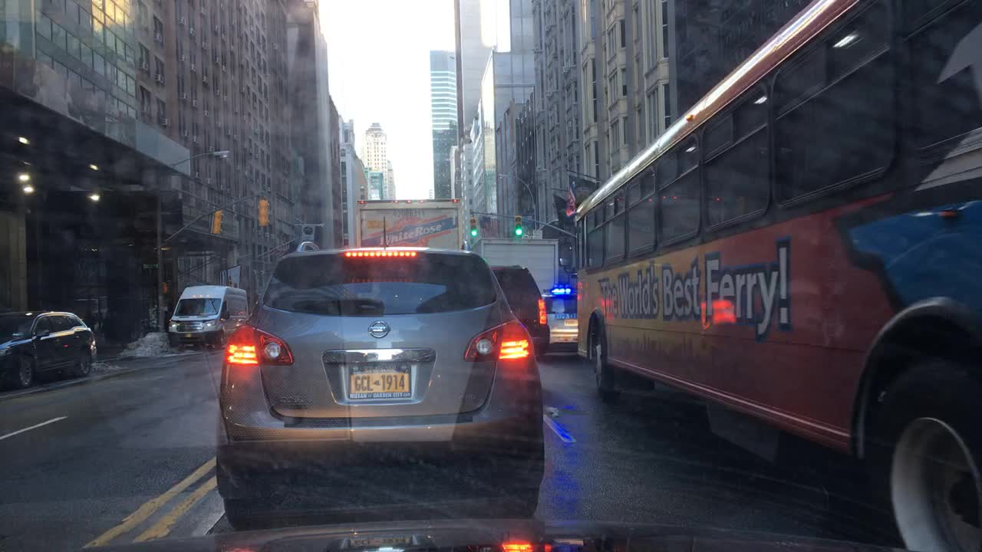
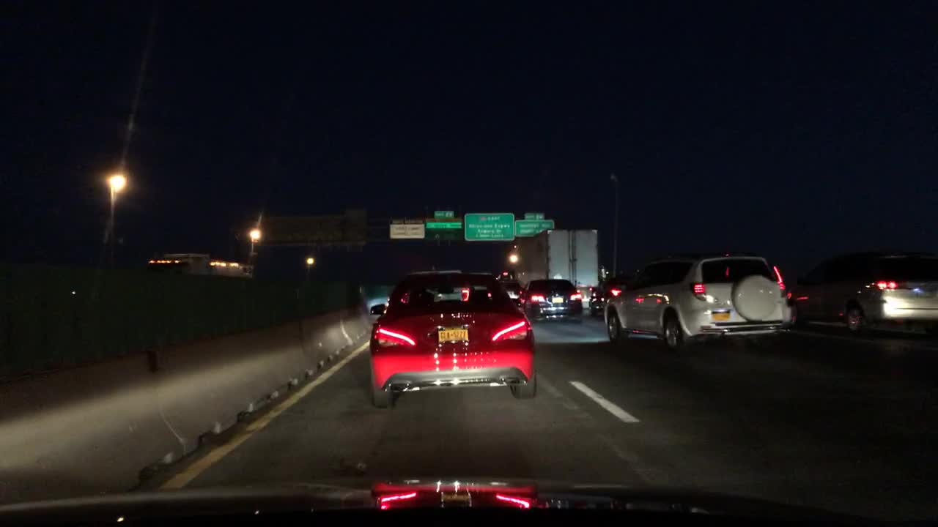
Our Proposal
Multi-stage transfer learning
BDD100k Dataset
Ex-1
Ex-2 night data
Advantages
BDD100k dataset has only the vehicle class and thus it’s the most relevant.
BDD100k also has low brightness data which mimics the fisheye night condition.

Slide 15
Our Proposal
Multi-stage transfer learning
BDD100k Dataset
 | Training | Validation | Total
Day | 36.5K | 5.2K | 41.7K
Night | 27.5K | 3.9K | 31.4K
Total | 64K | 9.1K | 73.1K

Slide 16
Our Proposal
Improvements
Day
Night
3%
4%
7%
Separating
Day and Night
Upsampling
Multistage Transfer Learning
Overall

Slide 17
Our Proposal
Improvements
Day
Night
5%
3%
3%
2%
4%
10%
7%
Separating
Day and Night
Upsampling
Multistage Transfer Learning
Overall

Slide 18
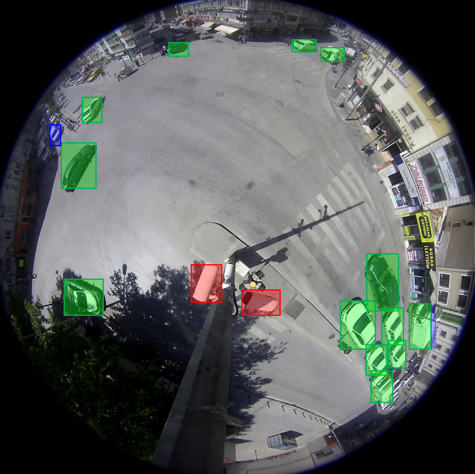
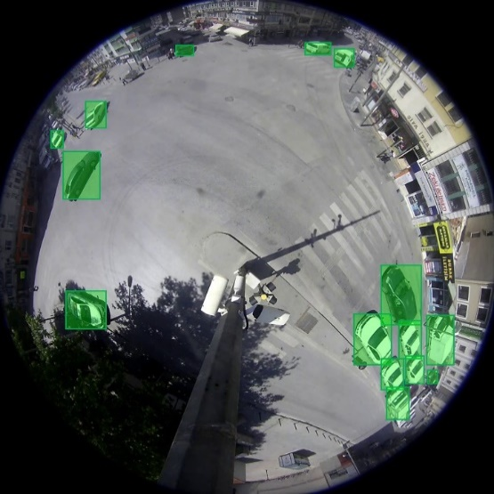
Results: Day
Without Our Proposal
With Our Proposal
True Positive
False Positive
False Negative

Slide 19
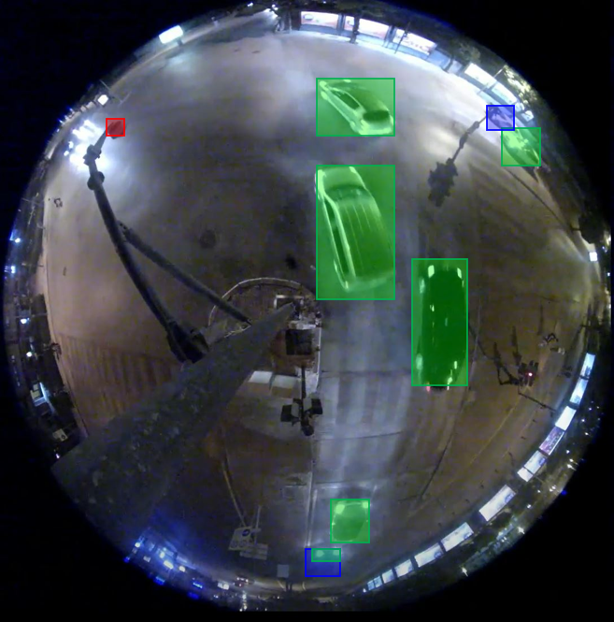

Results: Night
Without Our Proposal
With Our Proposal
True Positive
False Positive
False Negative

Slide 20
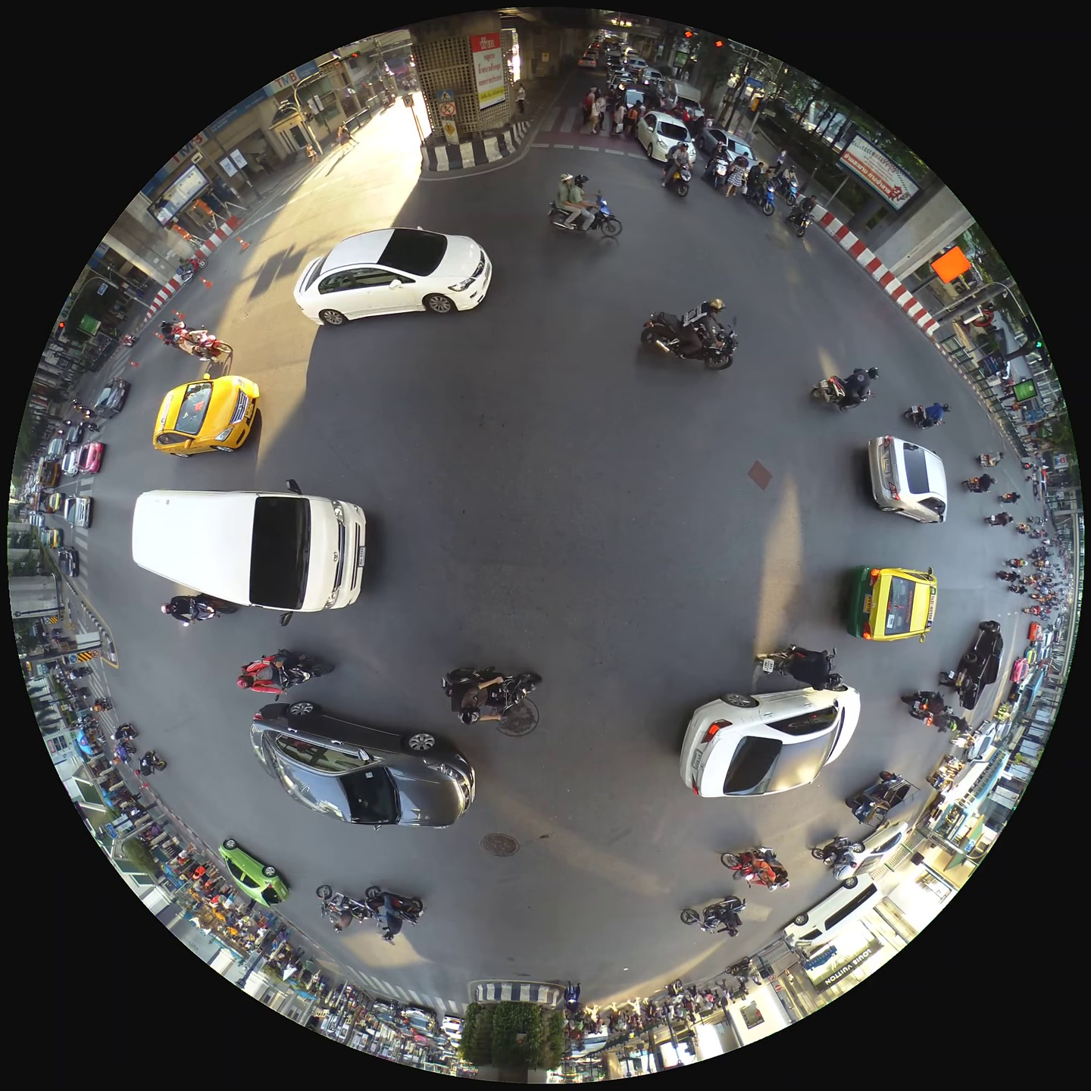
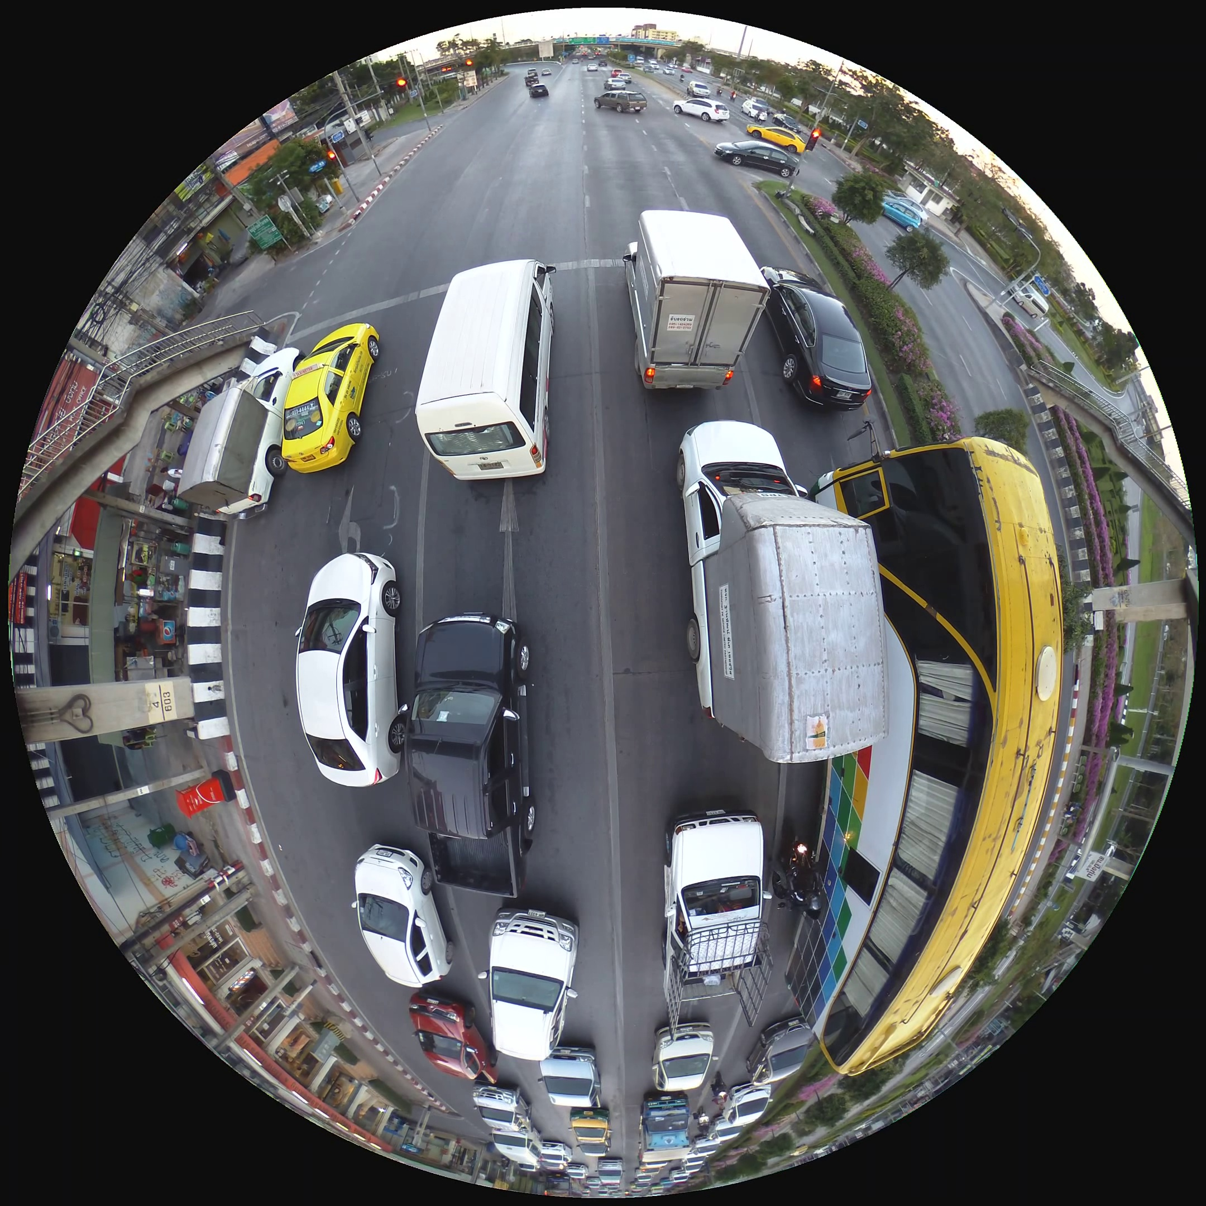
Further Improvements
Pseudo Labeled Dataset
Advantages
To get a more robust model
To handle unseen cases
Ex-1
Ex-2

Slide 21
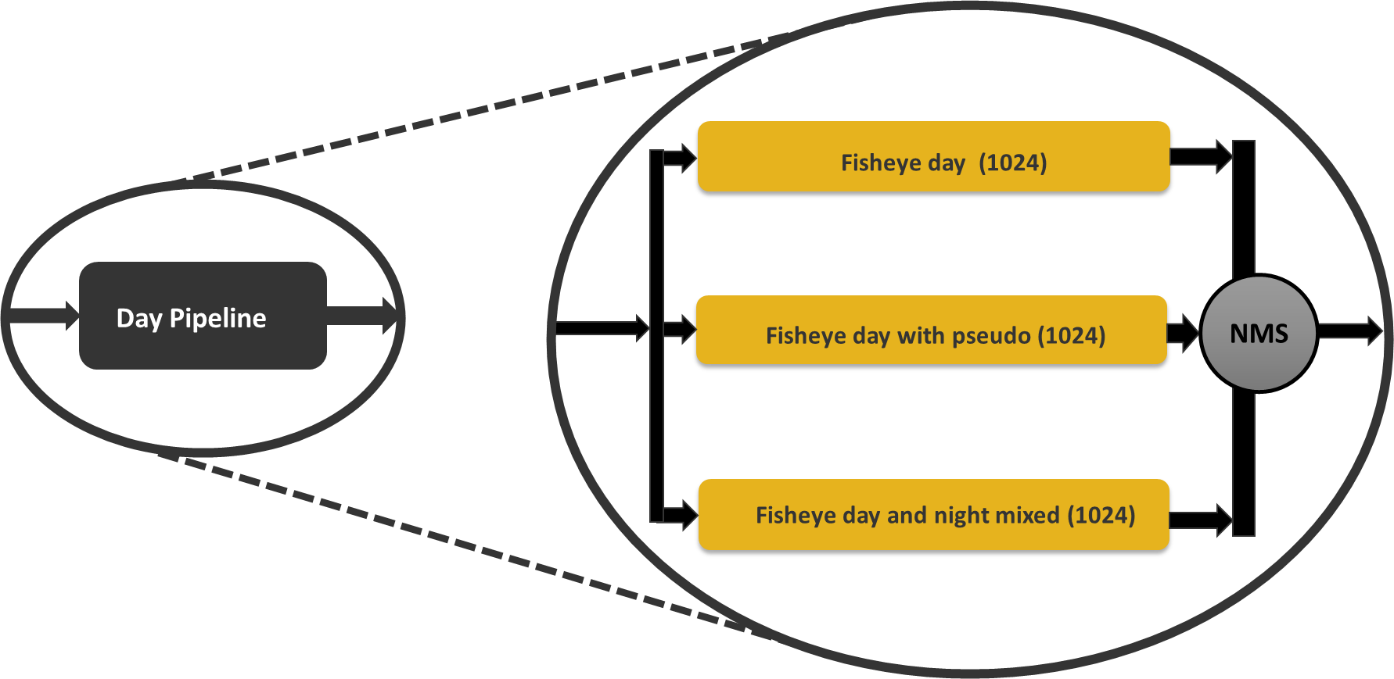
Further Improvements
Multi-stage Differentially Trained Ensemble
Day Case

Slide 22
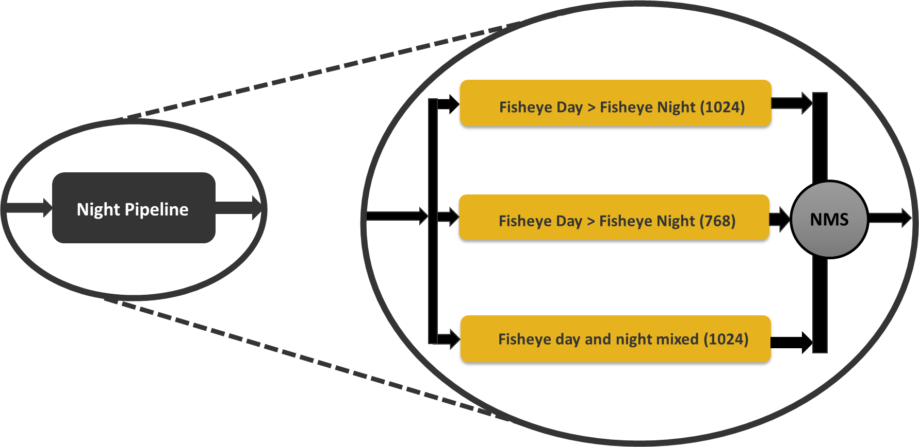
Further Improvements
Multi-stage Differentially Trained Ensemble
Night Case

Slide 23
Further Improvements
Improvements
2%
4%
8%
Training on pseudo dataset
Multistage differentially trained ensemble

Slide 24
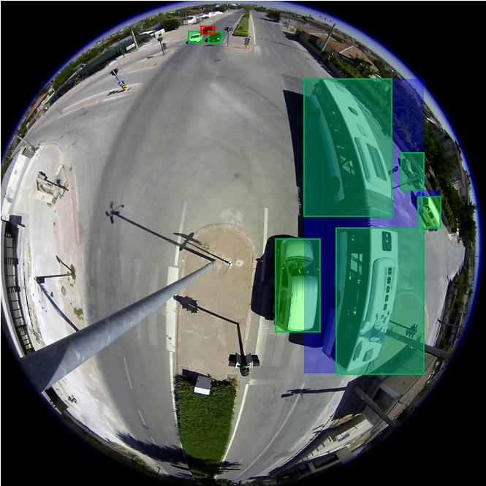
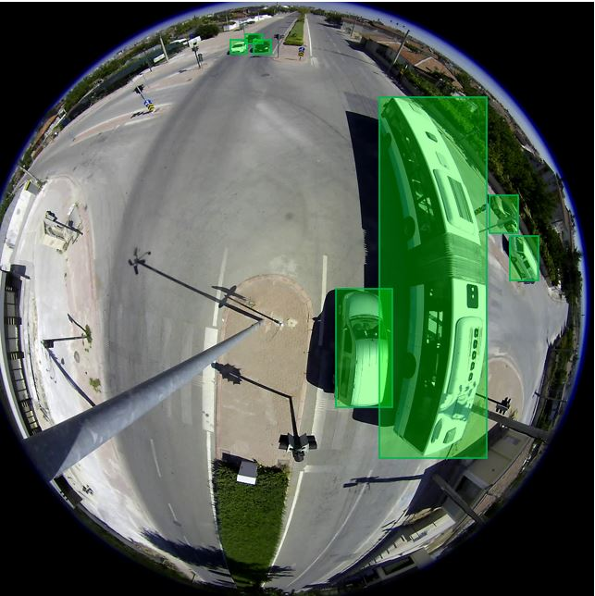
Day
Without Ensemble
With Ensemble
True Positive
False Positive
False Negative

Slide 25
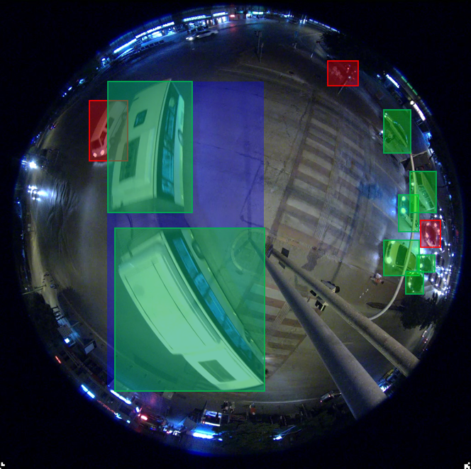
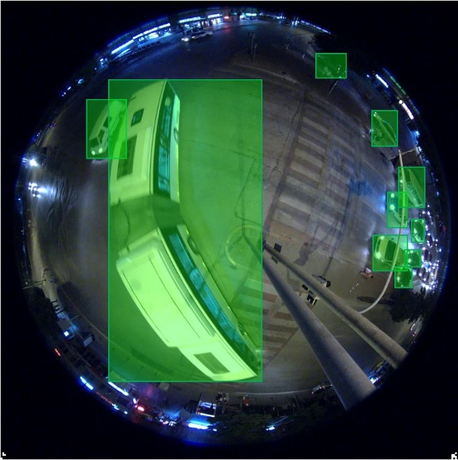
Night
Without Ensemble
With Ensemble
True Positive
False Positive
False Negative

Slide 26
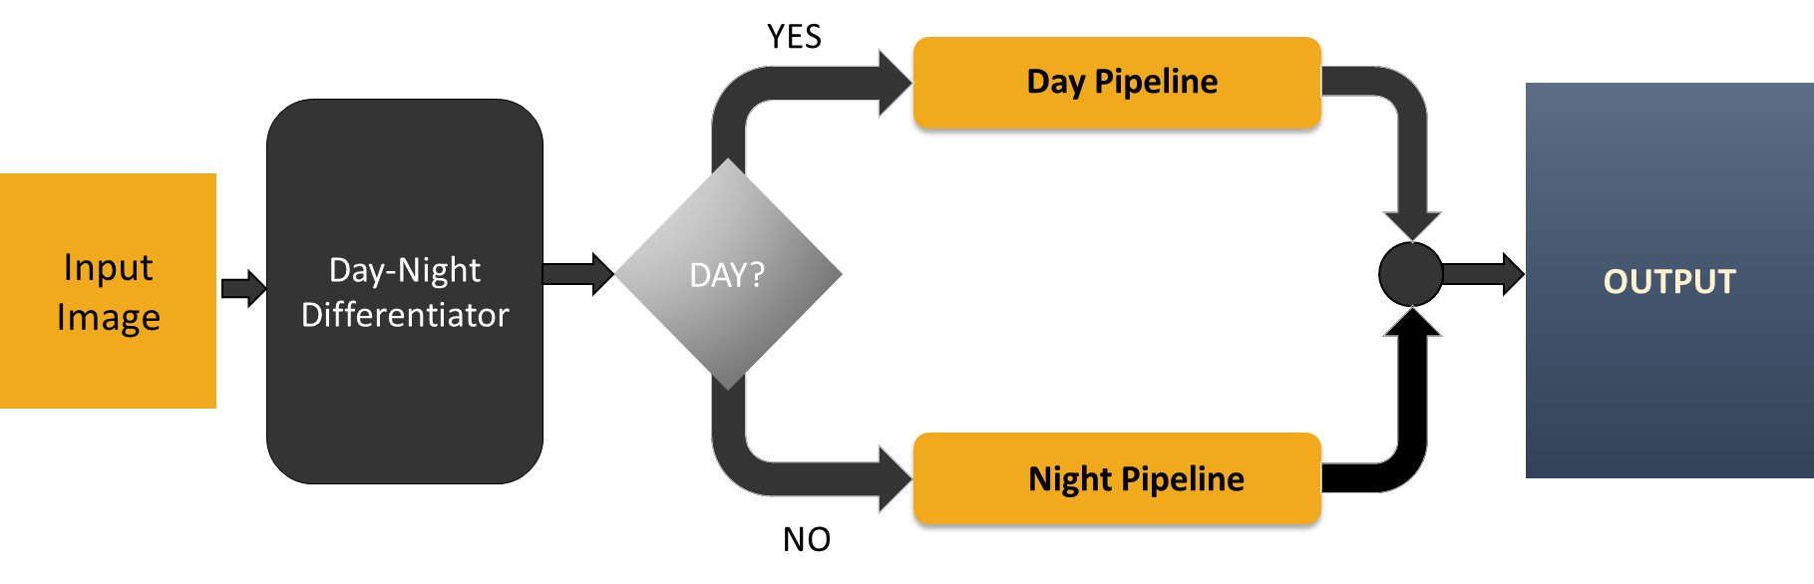
Day-Night Differentiator
Input
Image
Conv2D
3x3
Conv2D
3x3
Leaky
ReLU
Global
Average
Pooling
Leaky
ReLU
Dense
Dense
Decision
Day/Night
Sigmoid

Slide 27
Core Model
Backbone
A
Neck
D
Head
B
E
Input
Image
Output
Prediction
C
F

Slide 28
Backbone
Focus
Conv
3x3
Bottleneck
CSP
N=4
Shortcut=True
Conv
3x3
Bottleneck
CSP
N=12
Shortcut=True
Conv
3x3
Bottleneck
CSP
N=4
Shortcut=True
Conv
3x3
SPP
Bottleneck
CSP
N=4
Shortcut=False
A
B
C

Slide 29
Neck
A
D
Conv (1x1)
BottleNeck CSP
N=4
Upsample
Concatenate
B
Concatenate
Conv (3x3)
E
BottleNeck CSP
N=4
BottleNeck CSP
N=4
Conv (1x1)
Concatenate
Upsample
Conv (3x3)
C
F
Concatenate
BottleNeck CSP
N=4

Slide 30
Head
D
Conv
(1x1)
Output calculation & stacking
E
Conv
(1x1)
F
Conv
(1x1)

Slide 31
Building Blocks: Focus
Conv
3 x 3
Image concatenated to
channel 4*3 = 12
Input Image
Channel: 3

Slide 32
Building Blocks
Conv
k x k
Conv2D
k x k
BatchNorm
Hardswish
MaxPool 5x5
SPP
Conv2D
1 x 1
Concatenate
Conv2D
1 x 1
MaxPool 9x9
MaxPool 13x13

Slide 33
Building Blocks
Shortcut
BottleNeck
Conv
1 x 1
Conv
3 x 3
Shortcut = True/ False
N times
Conv
1 x 1
BottleNeck
Conv2D
1 x 1
BottleNeck
CSP
Shortcut
Conv2D
1 x 1
Concatenate
Batch
Norm
Leaky
Relu
Conv
1 x 1

Slide 34
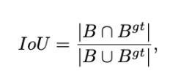
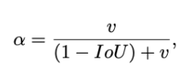
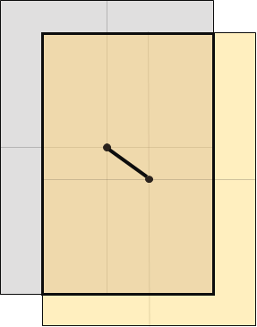
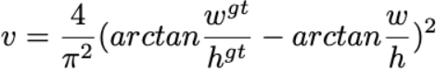
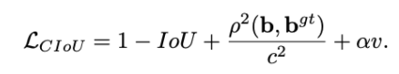
Loss Function: CIoU Loss
B
B^{gt}
d
C

Slide 35
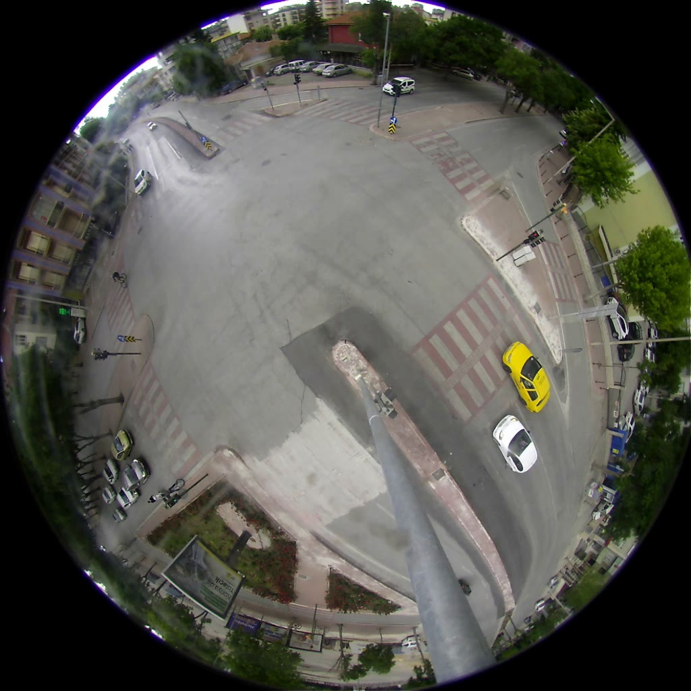

Tracking
“IOU Tracker” method was implemented for tracking the vehicles
Get Consecutive Images
Select vehicle from an image
Calculate its IOU of all vehicles from the next image
Get the vehicle with the maximum IOU. This is the same vehicle.

Slide 36
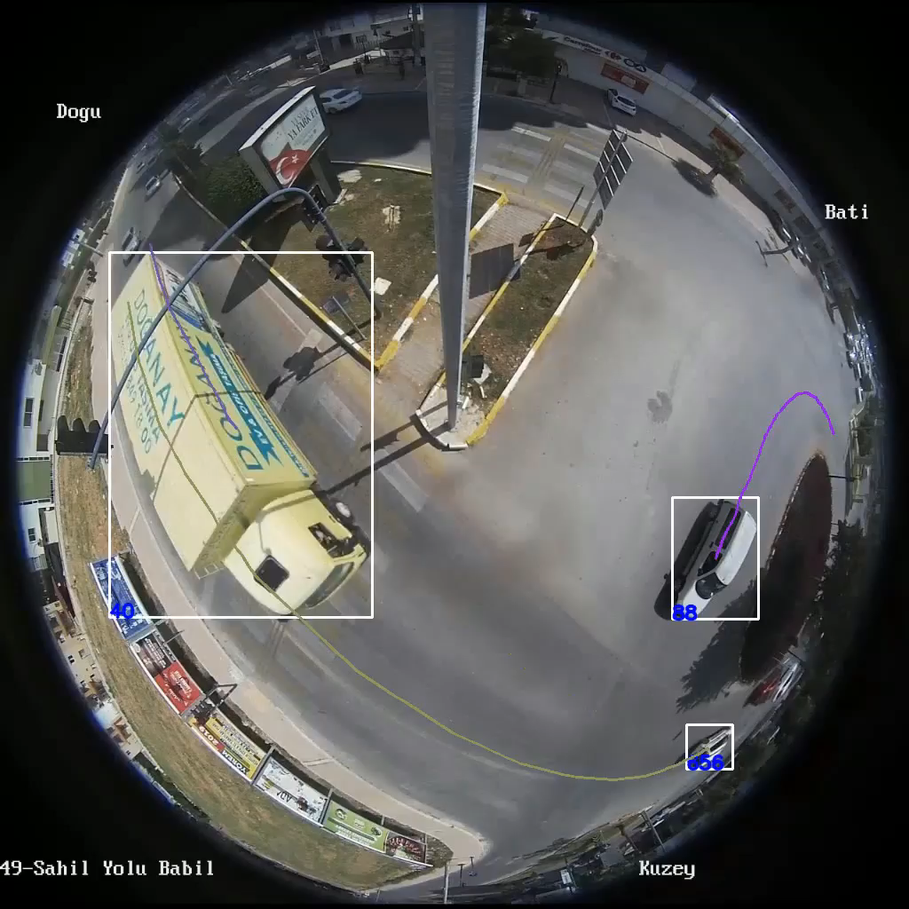
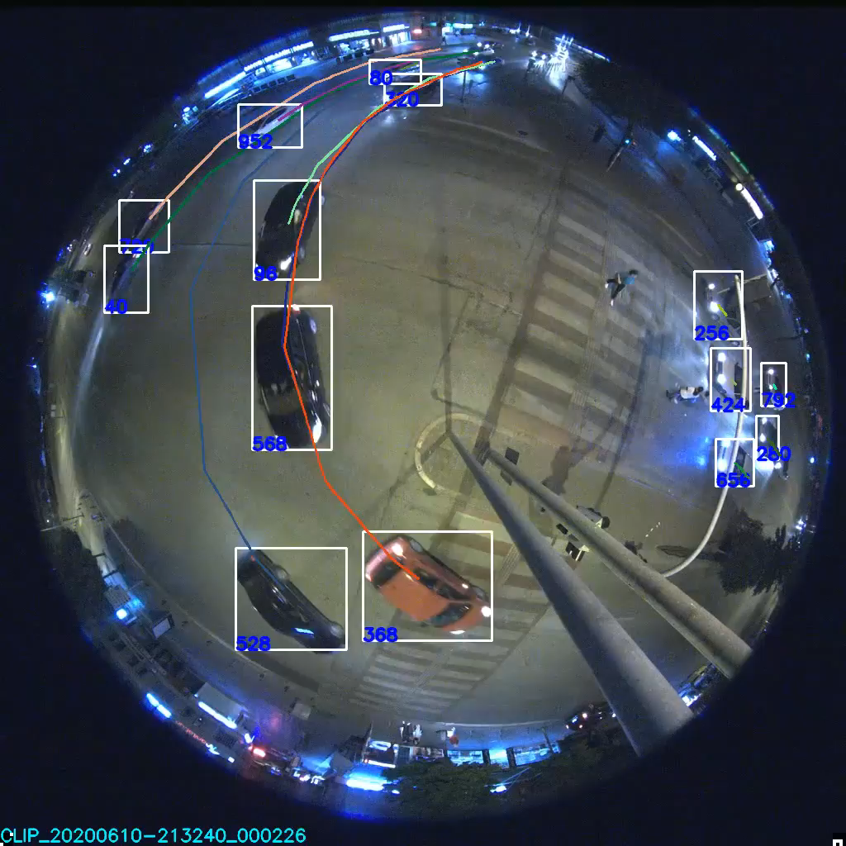
Tracking+Detection
Day
Night

Slide 37
Conclusion
Real time object detection.
Real time vehicle tracking.
Handling fisheye images.
Inference*
90 fps
30 fps
Single Model
Ensemble Model
*given necessary device

Slide 38
Thank You for your valuable time.

Slide 39
Any Question(s)?

